Slide 1



Green University of Bangladesh
Dept. of Computer Science and Engineering
Fall - 2024, Section- 221-D10
Course Title: Microprocessor and Microcontroller Lab
Course Code: CSE-304
Presented By:
Name | ID
Maruf Hossain | 221902318
Md. Tanvir Alam Anik | 221902283

Slide 2
Caesar Cipher Encryption-Decryption using Assembly Language
2
Presentation on

Slide 3

CONTENT
01
Introduction
02
Motivation
03
Design Goals & Objectives
04
Application
05
Tools
06
Features
07
Operation Workflow
08
Limitations
09
Scope of Future Work
10
Conclusion

Slide 4



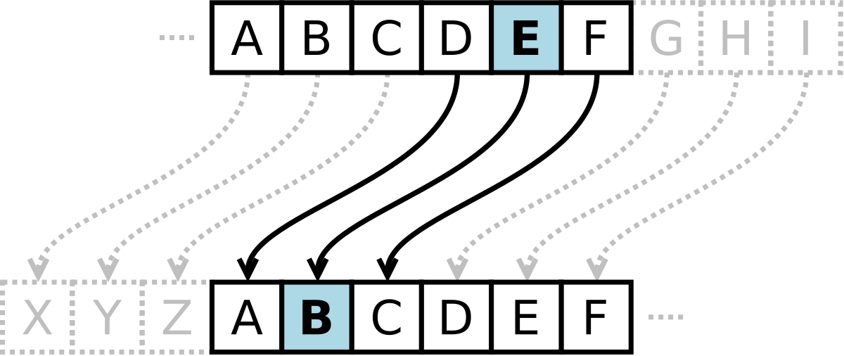
INTRODUCTION
What is Caesar Cipher?

Slide 5



MOTIVATION
To understand how encryption and decryption work.
To learn programming in 8086 assembly language.
To apply theoretical cryptography in a practical way.
To improve problem-solving and logic skills.
To explore basic methods for securing text.

Slide 6





GOALS AND OBJECTIVES
Build Logical Thinking
01
02
03
Learn Practical Cryptography
Implement a Caesar Cipher System

Slide 7


APPLICATION
01
02
03
04
Basic Data
Security
Educational
Tools
Puzzle & Game
Design
Captchas & Simple
Verification

Slide 8




FEATURES
Mode Selection
Custom Text
Input
Dynamic Length Support
Real-Time Output Display

Slide 9



OPERATION WORKFLOW:
Encrypted/
Decrypted text
Mode Selection
Text Length
Text

Slide 10
LIMITATIONS
Inefficient for large Data
No User Authentica-tion
Limited Security
Fixed Cipher
Shift

Slide 11
SCOPE OF FUTURE WORK
Graphical User
Interface
Better Optimization
03
01
02
Advanced Security Algorithm
User Authentication
Additional
Features
04
05
Cloud Integration
06

Slide 12


CONCLUSION

Slide 13



